Slide 1
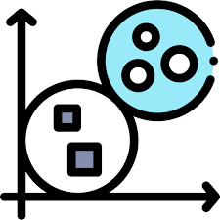
Machine Learning Clustering and Dimensionality Reduction
Week 5
Professor: Omar Altrad, PhD, P.Eng, PMP

Slide 2
Lecture 12: Introduction to generative adversarial networks (GANs)

Slide 3
Intended Learning Objectives:
Discuss the concept of GANs and deep convolutional GANs
Review the use of convolutional neural networks for image process filtering
Apply deep convolutional GANs to solve text and image classification learning problems

Slide 4
Introduction to Generative Adversarial Networks
GANs are a class of machine learning models introduced by Ian Goodfellow in 2014.
They consist of two primary components: a generator and a discriminator.
The generator aims to generate synthetic data (e.g., images) that resembles real data, while the discriminator tries to differentiate between real and fake data.
GANs operate in a competitive setting where the generator and discriminator learn from each other.
The generator's objective is to produce data that fools the discriminator, while the discriminator tries to improve its ability to distinguish between real and fake data.
Through an iterative process, GANs optimize their parameters to generate increasingly realistic and high-quality data.

Slide 5
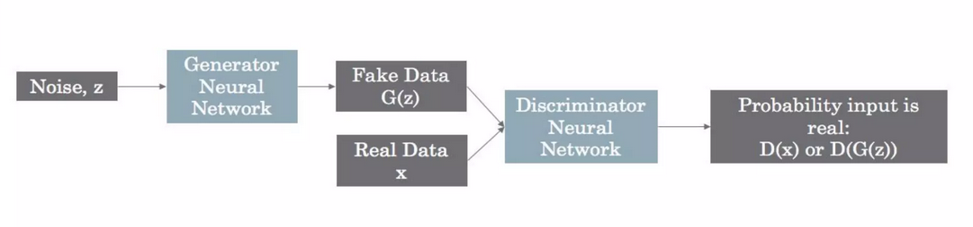
Introduction to Generative Adversarial Networks:

Slide 6
Deep Convolutional GANs (DCGANs):
DCGANs are an extension of GANs that leverage convolutional neural networks (CNNs) for both the generator and discriminator architectures.
CNNs are well-suited for image-related tasks, as they excel at capturing spatial patterns and hierarchies.
The generator network in DCGAN consists of convolutional layers followed by upsampling layers (such as transposed convolutions) to generate high-resolution data from random noise.
The discriminator network, which is a CNN-based classifier, receives input images and performs convolutional operations to classify them as real or fake.
DCGANs have several architectural guidelines to enhance stability and improve training, such as using convolutional and transpose convolutional layers, using batch normalization, avoiding fully connected layers, and employing appropriate activation functions (e.g., LeakyReLU).
DCGANs have shown remarkable success in generating realistic images by capturing intricate details, textures, and global coherence.

Slide 7
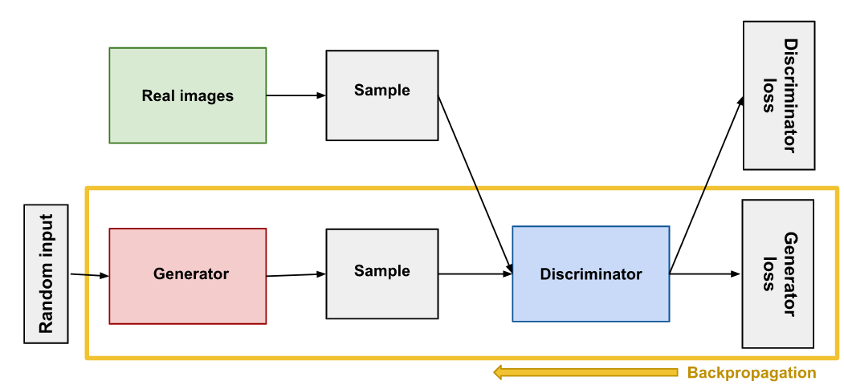
Deep Convolutional GANs:

Slide 8
Advantages of DCGANs:
DCGANs allow the generation of highly realistic and high-resolution images.
By using convolutional layers, DCGANs can learn and capture spatial features and patterns effectively.
DCGANs leverage the power of deep learning and CNNs to generate images with fine details and structures.
They can learn and generate diverse samples, enabling the exploration of different styles and variations in the generated data.
In summary, DCGANs combine the power of GANs and convolutional neural networks to generate high-quality images. They have demonstrated exceptional performance in various image-related tasks, opening up possibilities for creative applications and advancing the field of generative modeling.

Slide 9
Applications of DCGANs:
Image synthesis :
DCGANs can generate synthetic images, which find applications in art, design, and entertainment.
Data augmentation:
DCGANs can be used to create additional training data to improve the performance of other computer vision models.
Style transfer:
DCGANs can learn and transfer artistic styles from one image to another.
Image editing:
DCGANs can help modify images by adding or removing specific features.
Medical imaging:
DCGANs can generate synthetic medical images for research, training, or data privacy purposes.

Slide 10
Applied Example:
Step 1: Import the necessary libraries and modules
Step 2: Load and preprocess the dataset
import numpy as np
import matplotlib.pyplot as plt
from tensorflow.keras.models import Sequential
from tensorflow.keras.layers import Dense, Conv2D, Conv2DTranspose, Reshape, Flatten, LeakyReLU
from tensorflow.keras.datasets import mnist
from tensorflow.keras.optimizers import Adam
# For image classification (MNIST dataset)
(x_train, _), (_, _) = mnist.load_data()
# Normalize and reshape the image data
x_train = (x_train.astype('float32') - 127.5) / 127.5
x_train = np.expand_dims(x_train, axis=-1)

Slide 11
Applied Example:
Step 3: Define the generator network
def build_generator():
generator = Sequential()
generator.add(Dense(7 * 7 * 128, input_dim=100))
generator.add(LeakyReLU(alpha=0.2))
generator.add(Reshape((7, 7, 128)))
generator.add(Conv2DTranspose(64, kernel_size=4, strides=2, padding='same'))
generator.add(LeakyReLU(alpha=0.2))
generator.add(Conv2DTranspose(1, kernel_size=4, strides=2, padding='same', activation='tanh'))
return generator
generator = build_generator()

Slide 12
Applied Example:
Step 4: Define the discriminator network
def build_discriminator():
discriminator = Sequential()
discriminator.add(Conv2D(64, kernel_size=4, strides=2, padding='same', input_shape=(28, 28, 1)))
discriminator.add(LeakyReLU(alpha=0.2))
discriminator.add(Conv2D(128, kernel_size=4, strides=2, padding='same'))
discriminator.add(LeakyReLU(alpha=0.2))
discriminator.add(Flatten())
discriminator.add(Dense(1, activation='sigmoid'))
return discriminator
discriminator = build_discriminator()

Slide 13
Applied Example:
Step 5: Compile the discriminator
Step 6: Compile the combined model (generator + discriminator)
discriminator.compile(loss='binary_crossentropy', optimizer=Adam(learning_rate=0.0002, beta_1=0.5), metrics=['accuracy'])
discriminator.trainable = False # To freeze the discriminator during combined model training
z = Input(shape=(100,))
generated_image = generator(z)
validity = discriminator(generated_image)
combined_model = Model(z, validity)
combined_model.compile(loss='binary_crossentropy', optimizer=Adam(learning_rate=0.0002, beta_1=0.5))

Slide 14
Applied Example:
Step 7: Train the DCGAN
epochs = 100
batch_size = 128
num_batches = x_train.shape[0] // batch_size
for epoch in range(epochs):
for batch in range(num_batches):
# Train the discriminator
real_images = x_train[batch * batch_size : (batch + 1) * batch_size]
real_labels = np.ones((batch_size, 1))
fake_images = generator.predict(np.random.normal(0, 1, (batch_size, 100)))
fake_labels = np.zeros((batch_size, 1))
d_loss_real = discriminator.train_on_batch(real_images, real_labels)
d_loss_fake = discriminator.train_on_batch(fake_images, fake_labels)
d_loss = 0

Slide 15
Resources:
Patel, A. A. (2019). Hands-On Unsupervised Learning Using Python: How to build applied machine learning solutions from unlabeled data.

